Slide 1
Towards improved estimates of sea-ice algal biomass: experimental assessment of hyperspectral imaging cameras for under-ice studies
Discussion Slides – GPGN 570
2/13/2025 – Anastasia Horne

Slide 2
Overview & Purpose
Why is sea-ice algae important?
Goal
Impacts the rate of carbon export
Essential food source in polar marine ecosystems
Assess the viability of using hyperspectral imaging to map algal-biomass at the ice/water interface of an icesheet.
Steps
Why hyperspectral imaging?
Created an inverted sea-ice simulation tank analogous to natural sea ice conditions
Introduced Antarctic algal cultures at different concentrations into contained cylinders in the tank
Took a series of images at different spectral resolutions (1.7, 3.4, 6.7 nm)
Use Principal Component Analysis (PCA) to track variable features in the spectral dimension
Non-invasive
Map spectral signatures across a large area at multiple spectral resolutions
Measures the transmitted light
Chlorophyl A absorbs more red (680nm) and blue (450nm) wavelengths than ice and water

Slide 3
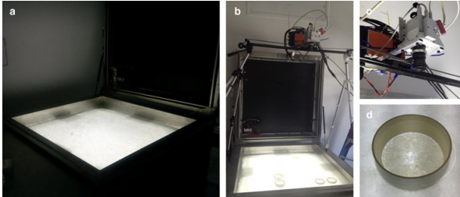
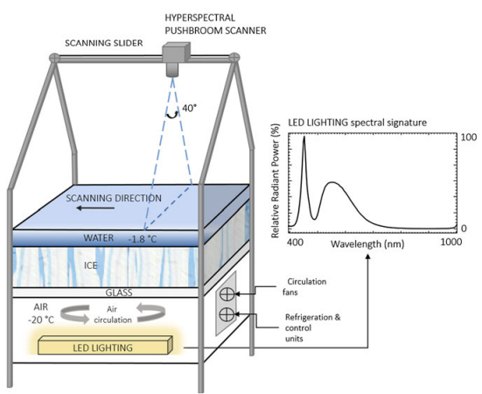
Experimental Setup
Tank Configuration
0.85m x 0.85m ice area
70mm ice thickness
20-30mm sea water layer above the ice
Glass between ice and LED was optically clear
Algal Treatment
3 different algal cultures extracted from Antarctica were cultivated
Different volumes placed in 8-80mm cylinders
4 PVC cylinders (C1, VL, MH, VH)
4 Acrylic cylinders (C2, L, M, H)
Fig. 2
Hyperspectral Imaging System
Pushbroom SPECIM AISA KESTRAL 10 camera
Camera was attached to a motorized sliding track
Placed 1m above ice/water interface
Paper stated 0.9mm spatial resolution
Took 2048 pixels and binned into 1020
Collected images at 1.7, 3.4, and 6.8 nm spectral resolution
Fig. 1
Notes:
for the slide with experiment setup maybe add the dimensions from the paper into Fig 1
summarize the experiment steps into bullet points or a list

Slide 4
Data Collection
Fig. 2
Validation Data
Hyperspectral Images
Image Processing
Chl-a concentration sampled from cylinders
5 random 1cm^2 spots per cylinder
10 mL of water/ice per spot
Images taken in dark room
3 days after introduction of algae, images were taken
One image per spectral resolution
Images were converted to radiance values
ROI filtering to remove areas that were not ice/water interface
Savitzy-Golay filter to reduce high-frequency noise
Notes:
what does integration time mean for HI
they mentioned the 0.9mm square spatial resolution three separate times

Slide 5
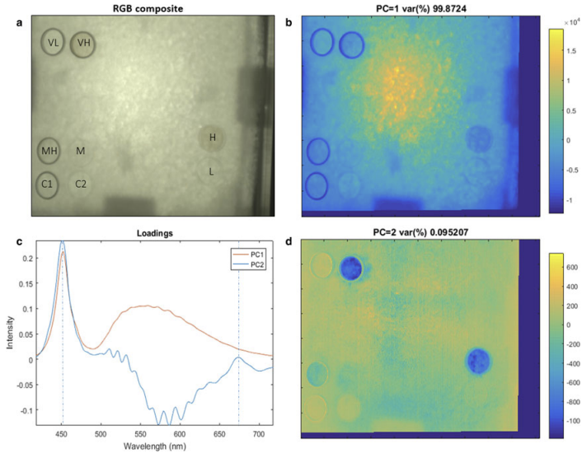
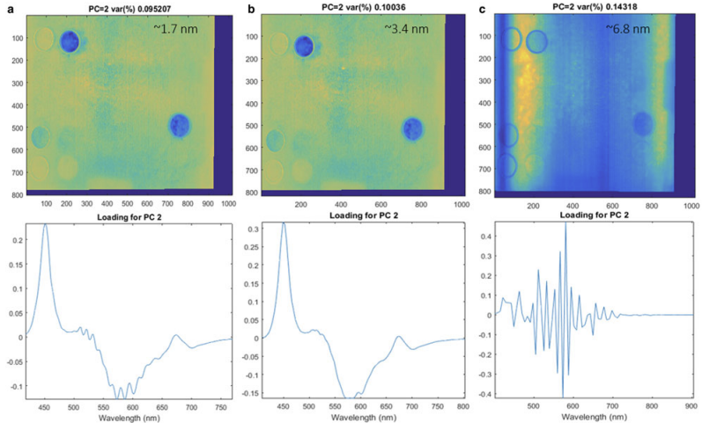
Results - Principal Component Analysis
Fig. 3
Fig. 4
1.7nm Results:
Spectral Results:
PC1 accounted for 99.8% of spectral variability
PC1 represents variations in the LED light source
PC2 accounted for 0.09% of spectral variability
PC2 peak intensities at ~450 & 680 nm (blue and red)
PC2 represents algal biomass distribution but between 500-650nm something else impacts PC2
For both 1.7nm and 3.4nm spectral resolution, PC2 has clear peaks at the expended bands
For 6.8nm intensity is scattered for all wavelengths, and the intensity image does not show a distinction between high concentration of biomass and low concentration
Notes:
look up what PC intensities mean, and what loadings mean

Slide 6
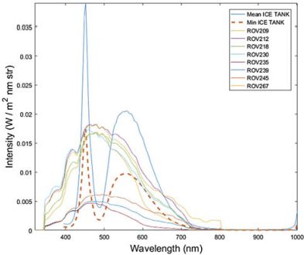
Results – In-Situ vs. Experimental Setup
Air
Radiance intensity measurements from the tank match in-situ measurements
Ice
Light was scattered like ‘real-ice’
Tank ice had lamellar ice crystals, and brine and air pockets
PCA results suggest indifference to the spatial variability in light intensity, so impacts of snow on light intensity may not matter
This needs to be investigated further
Algae
In the tank algae resided at the ice/water interface only
In-situ ice-algae concentrations might vary vertically
In tank cultures were at maximum growth rate with no decay
Fig. 5
Notes:
talk about experimental set up and "proof of concept" as a main point (use figure 1, 2)
maybe break up the above on the slides into the four sections the paper mentions (air, ice, algae, water)

Slide 7
Summary
Assess the viability of using hyperspectral imaging to map algal-biomass at the ice/water interface of an icesheet.
Inverted ice tank with controlled algal concentrations in cylinders, using a pushbroom hyperspectral sensor to measure transmitted light at different spectral resolutions.
Hyperspectral imaging captured distinct spectral signatures at algae absorption wavelengths (450 and 680nm), demonstrating potential for biomass mapping.
PCA separated light intensity variations (PC1, 99.8%) from algal biomass patterns (PC2, 0.09%), showing that spectral resolutions of 1.7 and 3.4nm could effectively detect biomass distribution while >6nm could not.
Need to develop the technique for field deployment, considering challenges like varying ice conditions, water column effects, and integration with underwater vehicles.

Slide 8
Discussion
Is there anything the paper did particularly well? Or was there something you think they could improve upon?
Based on the results and discussion do you think the experimental setup is analogous to the real-world conditions?
Why are hyperspectral cameras/images preferred over other imaging techniques?
Is there anything the experiment could have done better?
What are the most significant limitations of their approach?
Could their method be improved? If so, how?
What are the greater impacts of this research?
What other applications might this technology have in polar research?
The abstract states the “results highlight the potential…”. Are the results of the paper nontrivial?
Based off the future work section (last paragraph), how viable is this path of research?
How might the introduction of this technology change our approach to studying climate change impacts on other polar ecosystems?
What adaptations of this method might be needed for different types of sea ice or different seasons?
What is the purpose behind testing different spectral resolutions?

